Slide 1

IBM Data Science Capstone Project
Contoso Ltd.
Investing in Paris

Slide 2


Introduction
In this capstone project we will explore the location data of Paris and will try to answer to a specific question regarding opening a vegetarian restaurant.
Paris multi-cultural french city, it is a interesting type of restaurant because it is trendy right now.
The target of this report are stakeholders who want to invest in opening a vegetarian restaurant in Paris without knowing the right borough to do it.
The purpose of trying to have a look at Paris's boroughs is to find locations that don't have this type of restaurant, therefore it will be an opportunity for investors.
By categorizing the boroughs into clusters of venues we will try to answer the business problem of opening a vegetarian restaurant in Paris
Description and discussion of the business problem

Slide 3




Data Description
For the data retrieving we will set up some criterias :
Locations
Restaurants
Preferably close to the center.
List by borough
Trend
Trending venues in the area

Slide 4



Data description
for those criterias we will need to retrieve multiple data sets :
Paris
location
Dataset of Paris Arrondissements
the latitude and longitude of those districts.
Foursquare API
Dataset of venues

Slide 5
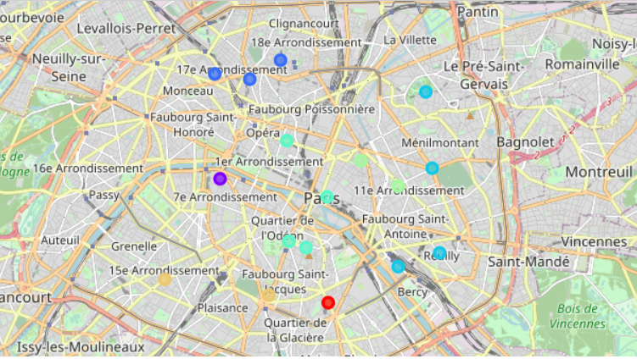
Methodology
K-means clustering algorithm to categorize each of the subdistricts within Paris
A one-hot encoding will be done on the venue dataframe and it will be grouped by subdistrict. The encoding will return venue categories as column per subdistrict, which will then be grouped to provide weighting of venue type occurence on each subdistrict.
The encoded dataframe will be further filtered into top venues before the K-means clustering algorithm will be run over it. This will return cluster labels over the subdistricts. The clusters will be observed one by one manually to determine its content.
Recommendation will be made based on the clusterring.

Slide 6


Analysis
Elbow technique and silhouette

Slide 7


Choosing the number of K clusters
Elbow technique
Silhouette
8 clusters.
Calculate the Within-Cluster-Sum of Squared Errors (WSS) for different values of k, and choose the k for which WSS becomes first starts to diminish. In the plot of WSS-versus-k, this is visible as an elbow.
10 clusters
The silhouette value measures how similar a point is to its own cluster (cohesion) compared to other clusters (separation).

Slide 8
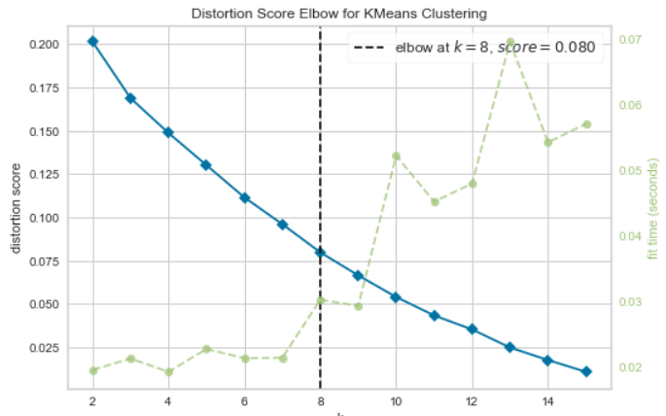
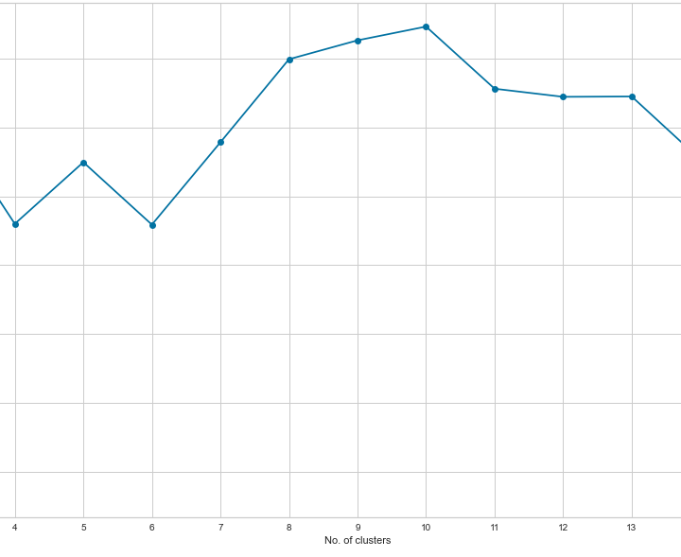
Results of the choice of k clusters

Slide 9
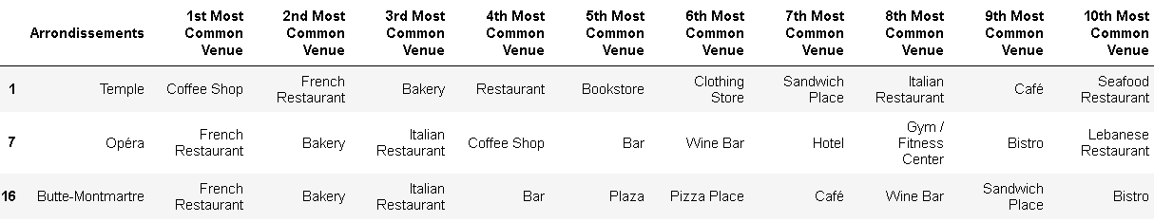
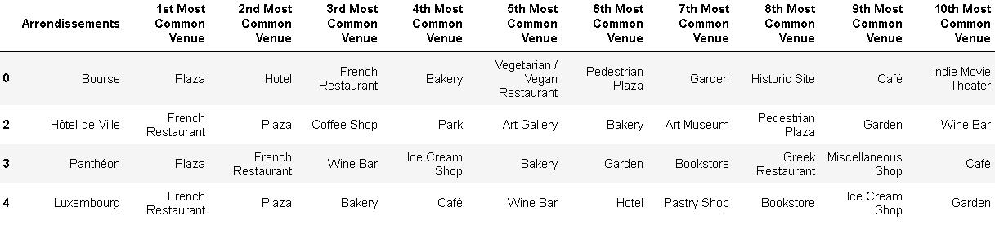
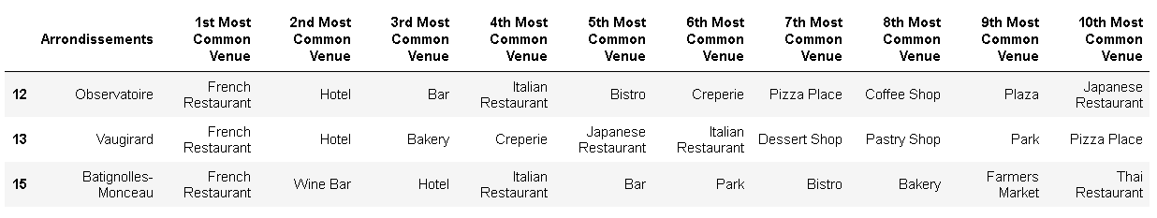
Analysis of clusters
Cluster 1,2 and 3 : These clusters contains mostly french restaurants in their most common venue

Slide 10
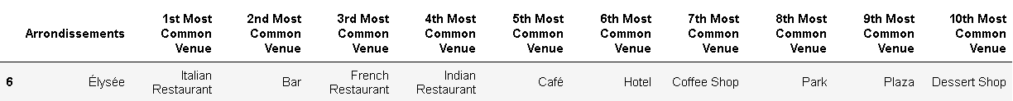
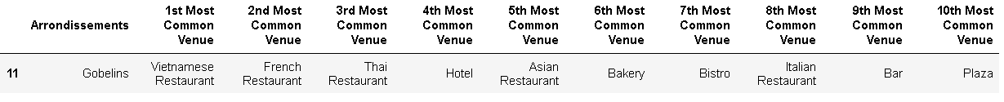
The most common venue in Elysée’s district is Italian restaurant
The most common venue in Gobelins district is Vietnamese restaurant

Slide 11
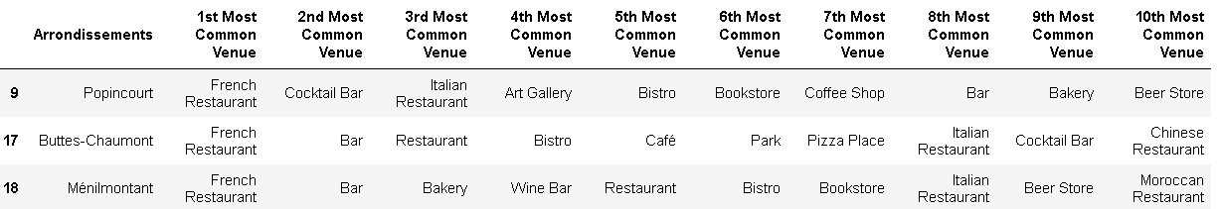
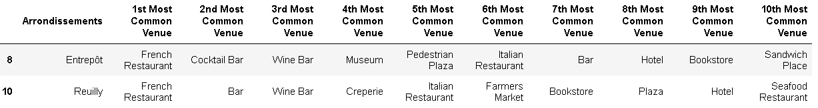
Those clusters follow the same pattern of the 3 first clusters as their most common venue is french restaurant

Slide 12
Results and Discussion

Slide 13

Results
The importance of restaurants but especially french ones
Acording to our clusters formation we can deduce the importance of restaurants in the french culture and in the urban landscape of venues,
This is due to the spread of the art of cooking after guilds were abolished after the french revolution,alowing french cooks to operate with fewer restrictions.
The influence of other culture is clearly visible amongst the clusters which contain for 2 of them Vietnamese and Italian as a most common venue.
The French have enjoyed an excellent cultural culinary exchange with many Asian countries. Vietnam, for instance, was a former French colony, which allowed the two countries to exchange culinary traditions.

Slide 14


Discussion
There are definite limitation with using the FourSquare API as the 100 venues limit might skew the result of the more densely populated subdistrict. Also, some subdistricts have low count of venues that it might be considered to be insufficient in determining its characteristics.
It might also be the case that FourSquare user base are skewed to the foodie type, which might explain the limited trending venues on the Elysée arrondissement

Slide 15


Conclusion
To conclude by answering to the bussiness problem we can say that opening a vegetarian restaurant is a niche market segment that is flourishing all arround the globe.
The under representative number of this type of restaurant make it easier to have a comparative advantage regarding the growing demand for those type of restaurants.
The vegetarian restaurant can be a good investment in all the arrondissements.

Slide 16





Merci de votre attention
Contoso Ltd.
David Paulet
+33 1 23 45 67 89
david@contoso.com
www.contoso.com

